Slide 1

Approximating solutions to Laplace’s equation

Slide 2
Introduction
In this topic, we will
  Introduce Laplace’s equation
  Discuss solutions to Laplace’s equation in one dimesion
  Convert the equation to a finite-difference equation in two and three dimensions
  Discuss how to create a system of linear equations to find an approximation to the solution
  Look at a number of examples both in two and three dimensions

Slide 3
Laplace’s equation
Laplace’s equation is reasonably straight-forward:
  This says that the sum of concavities at every point is zero
  Forces are proportional to acceleration,
  so this essentially says the forces at each point are balanced
  If all the forces are balanced,
  there will be no change to velocity
  If the system is not moving, it will remain so

Slide 4
Laplace’s equation
In one dimension, Laplace’s equation says
  This means that u(x) can be at most a straight line ax + b

Slide 5
Laplace’s equation
A solution is decided by boundary values:
  If u(a) = u_{a} and u(b) = u_{b}, we have a trivial unique solution:
  If u(a) = u_{a} and u⁽¹⁾(b) = u_{b}⁽¹⁾, we have another trivial unique solution:
  If u⁽¹⁾(a) = u_{a}⁽¹⁾ and u⁽¹⁾(b) = u_{b}⁽¹⁾, we either have no solutions or infinitely many solutions
    Sound familiar?

Slide 6
Laplace’s equation
Notice that for if a solution satisfies Laplace’s equation,
it is also a steady-state solution for both the heat equation
and the wave equation
  A solution to the heat equation converges to a solution of Laplace’s equation
  A solution to the wave equation oscillates around a solution to Laplace’s equation

Slide 7
Finite-difference approximation
In two and three dimensions, it becomes more interesting:
  In two dimensions,
  this requires a region in the plane with a specified boundary
  In three dimensions,
  this requires a volume with a specified boundary
  A Dirichlet (fixed) or Neumann (fixed derivative) must be specified at each point on the boundary

Slide 8
Finite-difference approximation
Applications of Laplace’s equation include:
  If all the walls in a room are either insulated or at fixed (and possibly different temperatures), the temperatures throughout the room will converge to a solution to Laplace’s equation
    The gradient would specify the direction of maximum increase in temperature at any point
  If each point on a boundary either has a specified fixed voltage or is insulated, and the region is devoid of any charges, the potential throughout the region is specified by Laplace’s equation
    The gradient of the solution specifies the direction that a test charge would follow

Slide 9
Approximating solutions
As before, substitute our divided-difference approximations for the second partial derivative into the equation
  Multiply both sides by –h² and collect:

Slide 10
Approximating solutions
Suppose that a region in the plane is entirely contained within the rectangle defined by
[a_{x}, b_{x}] × [a_{y}, b_{y}]
b_{y}
15 V
0 V
5 V
a_{y}
a_{x}
Insulated boundary
b_{x}

Slide 11
Approximating solutions
Divide the region into n_{x} × n_{y} squares and define
x_{i} = a_{x} + ih
y_{j} = a_{y} + jh
y_{n}
_{y}
y₀
x₀
x_{n}
_{x}

Slide 12
Finite-difference approximation
Now substitute x_{i} and y_{j} into our equation
Next, recognize that x_{i} ± h = x_{i±1} and y_{j} ± h = y_{j±1},
We don’t know what u(x_{i}, y_{j}) is, so we will try to approximate it with an unknown u_{i,j}

Slide 13
Finite-difference approximation
We can visualize this as follows:

Slide 14
Finite-difference approximation
Note what this says:
Rewrite this as:
Now, divide by four:
  If u satisfies Laplace’s equation,
  then u(x_{i}, y_{j}) will be the average of the points around it

Slide 15
Finite-difference approximation
Now, if (x_{i}, y_{j}) is a boundary point,
its value or the slope at that point is already given
  Each point in red has a boundary value
y₉
15 V
0 V
5 V
y₀
x₀
Insulated boundary
x₁₆

Slide 16
Finite-difference approximation
Now, if (x_{i}, y_{j}) is a boundary point,
its value or the slope at that point is already given
  The voltage at each white point is unknown…
y₉
15 V
0 V
5 V
y₀
x₀
Insulated boundary
x₁₆

Slide 17
Finite-difference approximation
Let’s zoom in at a few points: u_{2,4}
  The finite-difference equation says:
y₉
15 V
0 V
u_{2,5}
u_{1,4}
u_{2,4}
u_{3,4}
u_{2,3}
y₂
5 V
x₀
x₁₁

Slide 18
Finite-difference approximation
Let’s zoom in at a few points: u_{9,3}
  The finite-difference equation says:
y₉
15 V
0 V
u_{9,4}
u_{8,3}
u_{9,3}
u_{10,3}
y₂
5 V
u_{9,2}
x₀
x₁₁

Slide 19
Finite-difference approximation
Let’s zoom in at a few points: u_{8,6}
  The finite-difference equation says:
y₉
u_{8,7}
15 V
u_{7,6}
u_{8,6}
u_{9,6}
0 V
u_{8,5}
y₂
5 V
x₀
x₁₁

Slide 20
Finite-difference approximation
Let’s zoom in at a few points: u_{8,8}
  The finite-difference equation says:
y₉
u_{8,9}
u_{9,8}
u_{7,8}
u_{8,8}
u_{8,7}
15 V
0 V
y₂
5 V
x₀
x₁₁

Slide 21
Finite-difference approximation
How do we deal with an insulated condition?
  If the derivative at an insulated boundary point is zero,
  then and so or
y₉
u_{8,9}
u_{8,8}
15 V
0 V
y₂
5 V
x₀
x₁₁

Slide 22
Finite-difference approximation
Let’s zoom in at a few points: u_{8,8}
  Substituting in the value u_{8,8} for the insulated point, we have
y₉
u_{8,9}
u_{9,8}
u_{7,8}
u_{8,8}
u_{8,7}
15 V
0 V
y₂
5 V
x₀
x₁₁

Slide 23
Finite-difference approximation
There are 89 unknowns in this layout
  If we repeated the previous process at each of these 89 points, we would have 89 linear equations in 89 unknowns
y₉
15 V
0 V
5 V
y₀
x₀
Insulated boundary
x₁₆

Slide 24
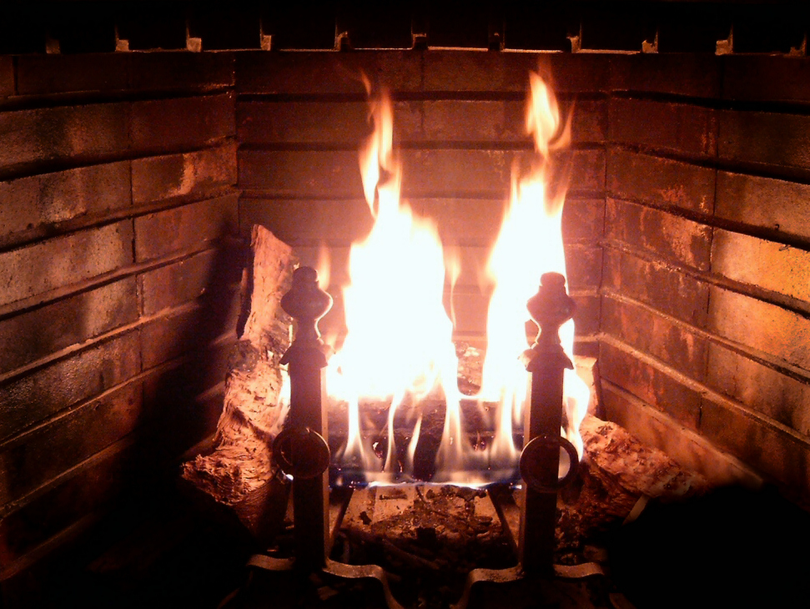
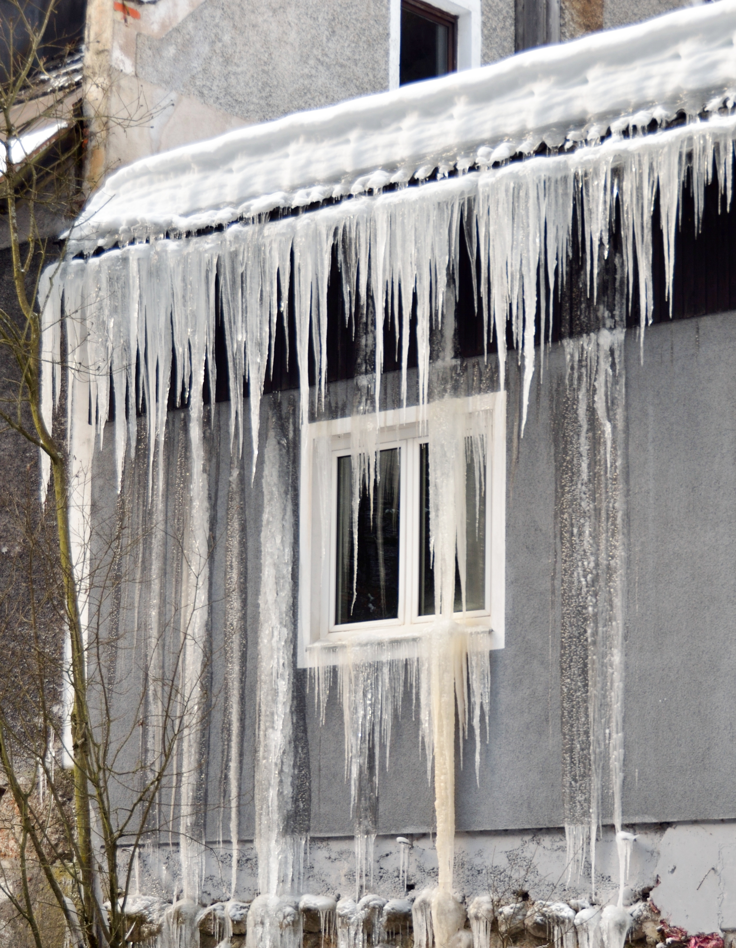
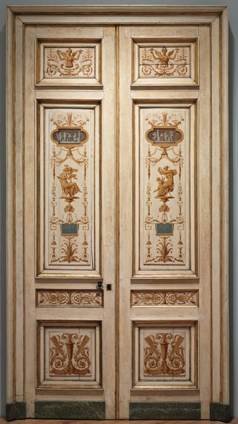
A simpler example
Here is an easier example
100°C
–5°C
User:Herzi Pinki
User:Belard
18°C

Slide 25
A simpler example
There are eleven interior points
u₁
u₂
u₃
100°C
–5°C
u₄
u₅
u₆
u₇
u₈
u₉
u₁₀
u₁₁
18°C

Slide 26
A simpler example
Here is the system of linear equations:

Slide 27
A simpler example
Copying the solutions back to our room
18.8
22.5
76.7
100°C
15.2
26.2
40.7
53.3
–5°C
20.7
26.2
31.9
42.6
18°C

Slide 28
Three dimensions
With a little effort, you should realize that the finite-difference approximation of Laplace’s equation in three dimensions is:
As before, the value at each point is the average of the six points surrounding it:

Slide 29
Three dimensions
We can visualize this as follows:

Slide 30
Three dimensions
Suppose we find a box in R³ is such that our region is entirely contained in
[a_{x}, b_{x}] × [a_{y}, b_{y}] × [a_{z}, b_{z}]
  This region should be such that it can be divided into cubes of dimensions h³ so b_{x} – a_{x} = n_{x}h, etc.
  Thus, we can define
x_{i} = a_{x} + ih
y_{j} = a_{y} + jh
z_{k} = a_{z} + kh
  We will approximate u(x_{i}, y_{j}, z_{k}) by u_{i,j,k}
  As in two dimensions, this will define a system of linear equations which we can solve

Slide 31
Example
Here is one example of such a problem:
  Consider a cube such that two opposite faces are at either 100 V or 100°C and the four remaining sides are at 0 V or 0°C
  We could choose an h so that n_{x} = n_{y} = n_{z} = 30

Slide 32
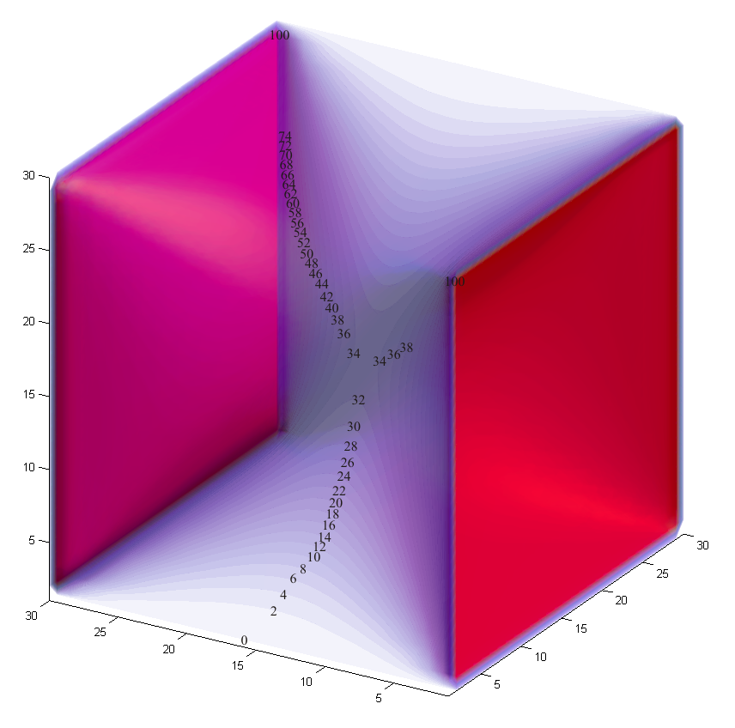
Example
Here is our approximation of the solution

Slide 33
Example
Here is another example of such a problem:
  Consider a cube such that all sides are at 0 V or 0°C and there are three point sources within that are at 100 V or 100°C
  Again, we could choose an h so that n_{x} = n_{y} = n_{z} = 30

Slide 34
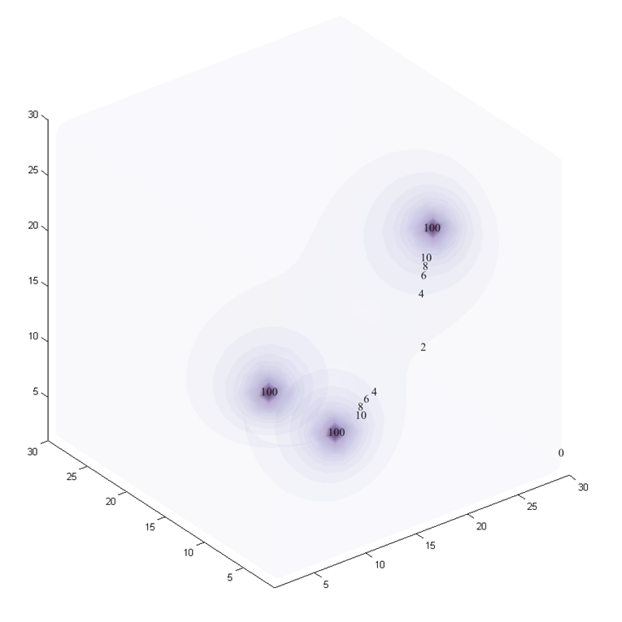
Example
Here is our approximation of the solution

Slide 35
Example
Here is another example of such a problem:
  Consider a cube such that one side is at 0 V or 0°C and the remaining five sides are insulated
  There is a point source at the center at 100 V or 100°C
  Again, we could choose an h so that n_{x} = n_{y} = n_{z} = 14

Slide 36
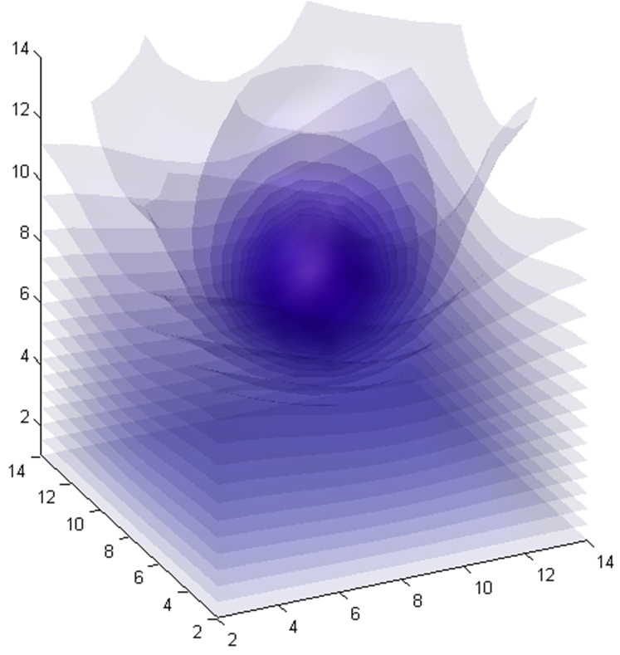
Example
Here is our approximation of the solution
16
33
10

Slide 37
Example
Thus, for most unknown points, the linear equation would be:
  If one of the six neighboring points is the source at 100,
  the equation would be
  If one of the six neighboring points is the wall kept at 0,
  the equation would be
  If one of the six neighboring points is an insulated point,
  the equation would be

Slide 38
Summary
Following this topic, you now
  Understand Laplace’s equation and its application
  Know how to convert Laplace’s equation into a finite-difference equation
  Know how to break a region into a grid of points
  Have seen four examples including Dirichlet (fixed) and
  insulated boundary conditions

Slide 39
References
[1] https://en.wikipedia.org/wiki/Laplace%27s_equation

Slide 40
Acknowledgments
None so far.

Slide 41



Colophon
These slides were prepared using the Cambria typeface. Mathematical equations use Times New Roman, and source code is presented using Consolas. Mathematical equations are prepared in MathType by Design Science, Inc.
Examples may be formulated and checked using Maple by Maplesoft, Inc.
The photographs of flowers and a monarch butter appearing on the title slide and accenting the top of each other slide were taken at the Royal Botanical Gardens in October of 2017 by Douglas Wilhelm Harder. Please see
https://www.rbg.ca/
for more information.

Slide 42
Disclaimer
These slides are provided for the ece 204 Numerical methods course taught at the University of Waterloo. The material in it reflects the author’s best judgment in light of the information available to them at the time of preparation. Any reliance on these course slides by any party for any other purpose are the responsibility of such parties. The authors accept no responsibility for damages, if any, suffered by any party as a result of decisions made or actions based on these course slides for any other purpose than that for which it was intended.

